Slide 1
Case 5: Hash Table using Red Black Trees storing frequencies
There are two parts in this case
Building the Data Structure(Insertion)
Searching the Data Structure
Notes:
<number>

Slide 2
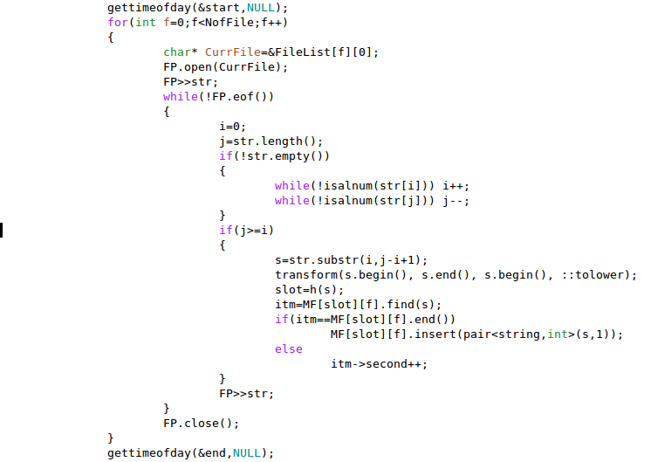
Building the Data Structure
The starting time is stored using object start of gettimeofday structure.
We traverse the string from the start and the end till we encounter alphanumeric characters in order to get rid of punctuations if any.
We take the valid substring and transform it in to lower case.
Slot number of the word is calculated.
We check if the word is already inserted in MF[slot][f].If yes, then we increment the frequency of the word or else we insert that word in MF[slot][f].
The finishing time is stored using object end of the gettimeofday structure.
Notes:
<number>

Slide 3
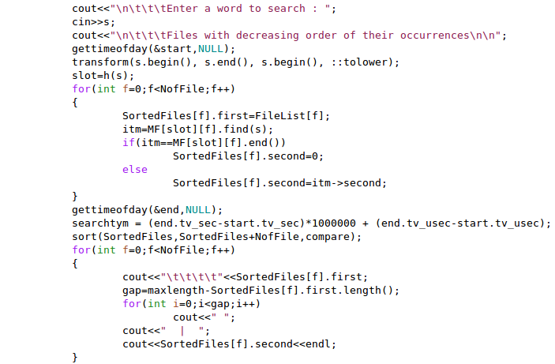
Searching the Data Structure
Enter a word to search
The starting time is stored using object end of gettimeofday structure.
Transform the word to lower case and calculate the slot number.
In each file search for the word in MF[slot][f] and store the frequency of word.
The file names are sorted on the basis of frequency of the word stored in each file.
The finishing time is stored using object end of gettimeofday structure.
Notes:
<number>

Slide 4
Asymptotic Analysis(Time and Space complexities)
Let m, F, f ,n be the number of slots, number of text files, total number of distinct words in the files and total number of words respectively.
Define α = n/(F x m), then α/f is the number of nodes in a Red Black Tree in each slot.
So for building the Data Structure, we take O(1) time to calculate the hash value(slot number) and O(log( α/f)) to insert the word in the Red Black tree for each word. So in total for n words building of Data Structure takes O(n log(α/f)) time.
For searching, first we need to calculate hash value(slot number) which takes O(1) time and then search the word in O(log(α/f)) time.(time required to search in a Red Black Tree).So Searching a word takes O(log(α/f)) time.
Space complexity is total number of nodes of Red Black Trees which is total number of distinct words which is O(n/f).
Notes:
<number>

Slide 5
Pros and Cons
Pros:
This algorithm reduces the building Data Structure time compared to case 4 by log(m).
This algorithm has best(fastest) searching time among all the five cases.
Cons:
This algorithm is n times slower in building the Data Structure compared to the case of building the Data Structure using normal Linked Lists.
Notes:
<number>

